Slide 1
Performing Mail Merges
Microsoft Word 2013
Lesson 11

Slide 2
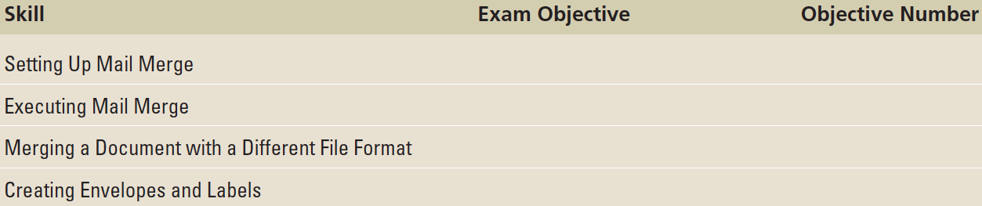
Objectives

Slide 3
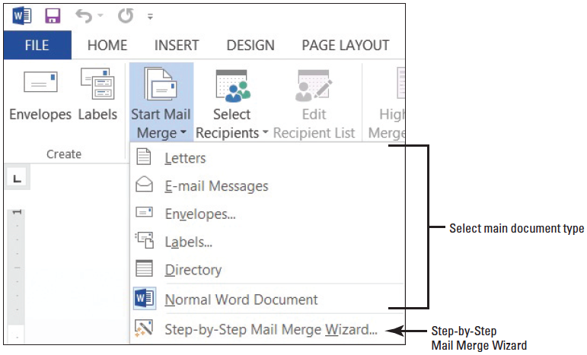
Step by Step: Set Up a Main Document Using the Mail Merge Wizard
GET READY. Before you begin these steps, be sure to launch Microsoft Word and open a blank document.
On the Mailings tab, in the Start Mail Merge group, click the Start Mail Merge menu drop-down arrow to display the Start Mail Merge menu as shown above.

Slide 4
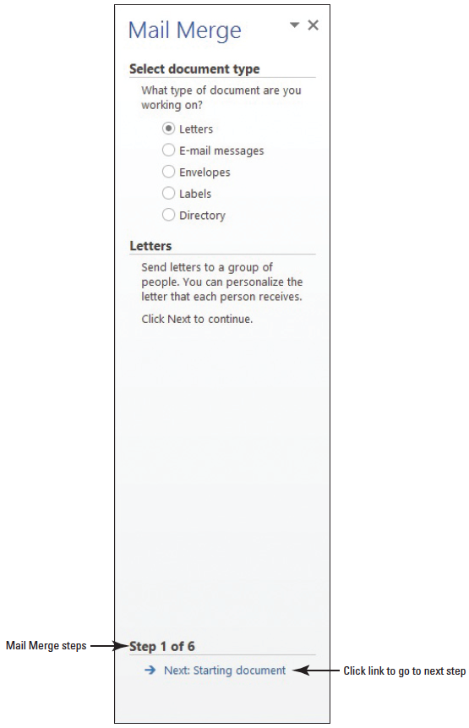
Step by Step: Set Up a Main Document Using the Mail Merge Wizard
Click Step-by-Step Mail Merge Wizard. The Mail Merge pane opens as shown at right. The Mail Merge Wizard has six steps to complete.

Slide 5
Step 1: Select the Document Type
Under the Select document type section, Letters is the default. You use the default for the main document.
Click the link below the Mail Merge pane, Next: Starting document.

Slide 6
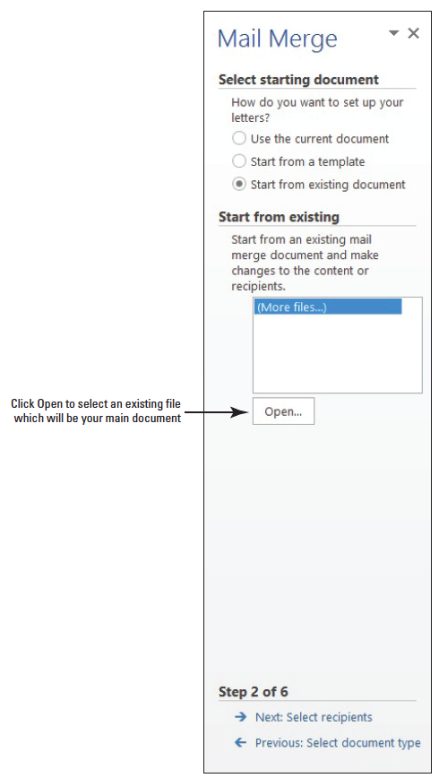
Step 2: Select the Starting Document
This step contains three options on setting up the letter. You open an existing document in the lesson folder.
Below the Select starting document section, click the Start from existing document radio button.
Below the section, Start from existing, click the Open button as shown at right. The Open dialog box displays.

Slide 7
Step 2: Select the Starting Document
Use the scroll bar to locate your flash drive and open data files from your lesson folder.
Select the Scholarship document and double-click to open it or click the Open button. The document is opened in the document screen.
At the bottom of the Mail Merge pane, click the Next: Select recipients link.

Slide 8
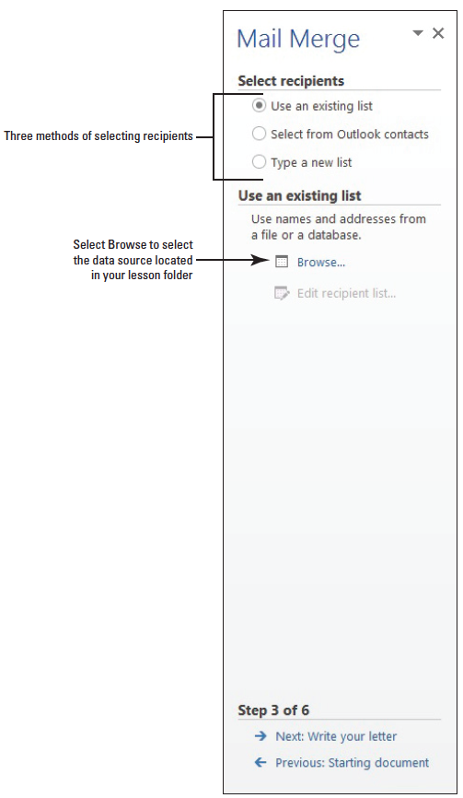
Step 3: Select the Recipients
Under the Select recipients section (right), you use the default setting, Use an existing list. The existing list is located in the data lesson folder in your flash drive.

Slide 9
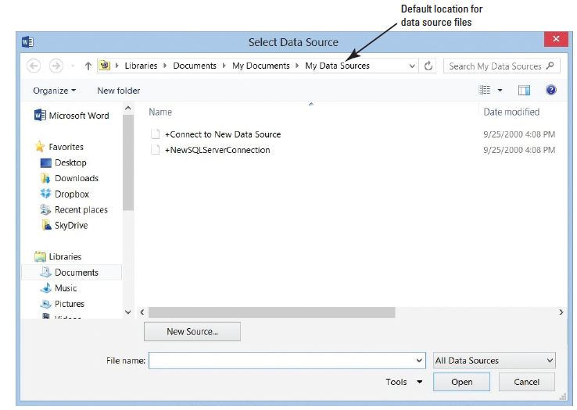
Step 3: Select the Recipients
Under the Use an existing list section, click the Browse link. The Select Data Source dialog box opens— this is the default location for data source files (right).
Use the scroll bar to navigate to the location of your data lesson folder in your flash drive.

Slide 10
Step 3: Select the Recipients
A data source is a file that contains information to be merged in the main document. A data source can be from an Excel spreadsheet, an Access database, or a Word document containing a single table, an electronic address book such as Outlook, or any text that has data fields.
Field names provide a description for the specific data, such as a person’s first name, last name, address, city, state, and zip code, to be merged from the data source. Fields usually correspond to the column heading in the data file.

Slide 11
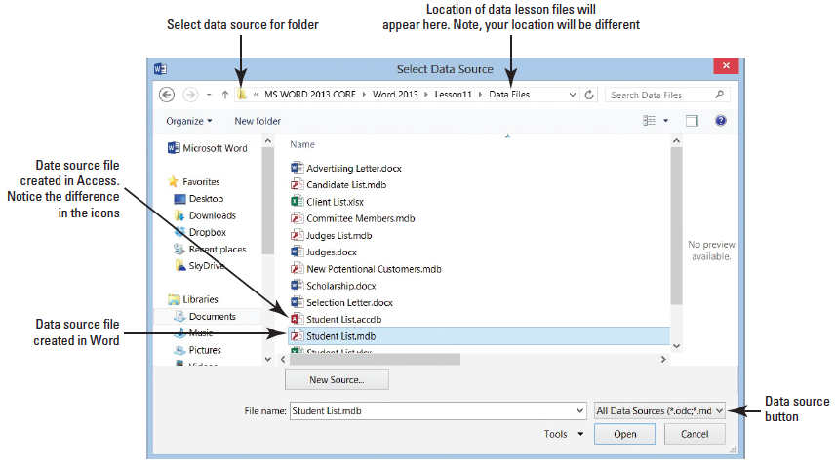
Step 3: Select the Recipients
Select the Student List.mdb as shown at right, and double-click or click the Open button.
The icon listed for the Student List.mdb is a database file created in Word—notice the difference in the icon between the database created in Word and Access.
A database is a collection of information that is organized so that you can retrieve information quickly. The Student List.mdb file is the data source that will be merged with the letter in the document screen.

Slide 12
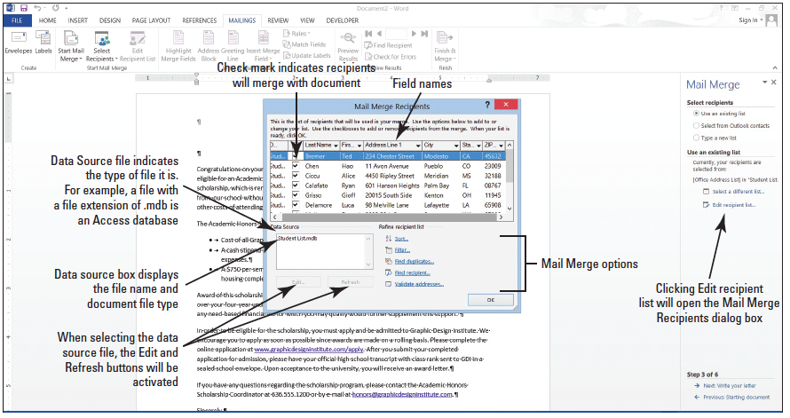
Step 3: Select the Recipients
The Mail Merge Recipients dialog box opens as displayed below.
The Mail Merge Recipients dialog box has been expanded to display all fields and records. The check mark indicates that all recipients’ fields will merge with the document.

Slide 13
Step 3: Select the Recipients
You can choose not to send a recipient a letter by unchecking the check box. When the document merges, all recipients with a check mark by their name will be merged with the document.
Click OK to close the Mail Merge Recipients dialog box and return to the document screen.

Slide 14
Step 4: Write Your Letter
At the bottom of the Mail Merge pane, click the Next: Write your letter link. Because you have already opened an existing document, the document is ready for fields to be inserted. Your insertion point should already be positioned on the blank line above the first paragraph to insert the current date.
Click the Insert tab, in the Text group, and click the Date & Time button. The Date & Time dialog box opens.

Slide 15
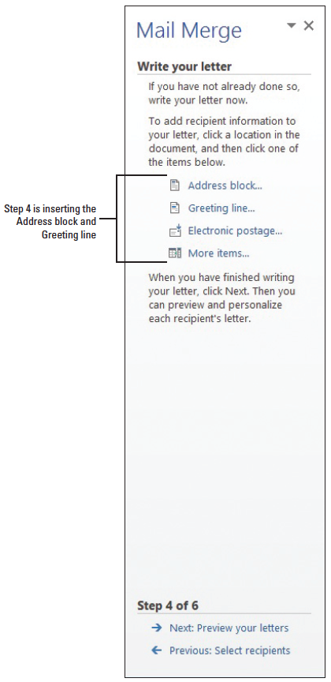
Step 4: Write Your Letter
Click the third option and click OK. The current date is inserted in the document.
Press Enter twice.
In the Mail Merge pane, under the Write your letter section, it shows four links (right). The Address block link contains the fields from the recipient’s list, the Greeting line link contains the salutation, the Electronic postage link inserts the electronic postage, and the More items link opens the Insert Merge Field dialog box, which provides an option to insert fields individually.
Under the Write your letter section, click the Address block link.

Slide 16
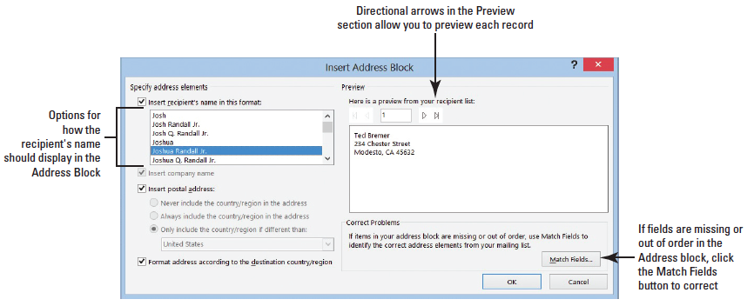
Step 4: Write Your Letter
The Insert Address Block dialog box opens as shown below. Under Specify address elements, insert recipient’s name in that format, the fifth option is selected with a specific format as displayed on the Preview section.

Slide 17
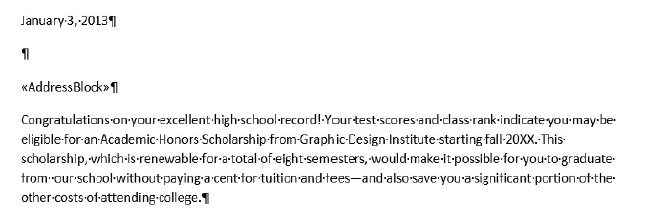
Step 4: Write Your Letter
Click the Next arrow and preview the ten records in the recipient list, and then click the First button to return to the first recipient.
Click OK. A field code <<Address Block>> is inserted in the document as shown below. The field name is surrounded by chevrons (<< >>) and do not display in the merged document. When the document is merged, the Address Block will be replaced with the recipients’ first and last name, address, city, state, and postal code.

Slide 18


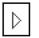

Step 4: Write Your Letter
On the Preview side, there are four arrows: First , Previous , Next , and Last . Notice that the First and Previous arrow buttons are grayed out. When these arrow buttons are shaded in gray, it indicates that these are not available because you are previewing the first record. The first recipient’s name and address is displayed and when you click the Next or Last arrow, the First and Previous arrows will become available.

Slide 19
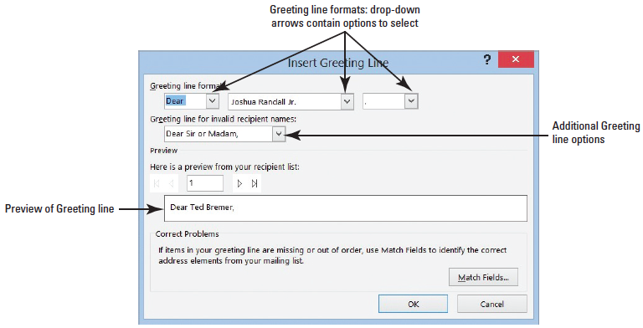
Step 4: Write Your Letter
Press the Enter key once.
Click the Greeting line link to open the Insert Greeting Line dialog box as shown below. The drop-down arrows under the Greeting line format provide options to select the salutation, name, and punctuation. You use the salutation Dear for the letter.
Notes:
Take Note: In the Insert Greeting Line dialog box, the comma is the default punctuation and is not used in most business letter formats.

Slide 20
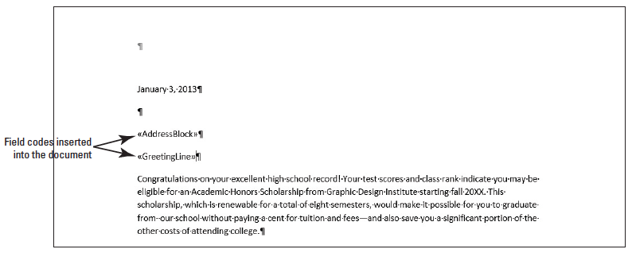
Step 4: Write Your Letter
Click the drop-down arrow next to Joshua Randal Jr. to view the options. Keep the default as the selection.
Click the drop-down arrow next to the comma and select the colon (:).
Click OK. Your document should match the figure below. You have inserted two field codes in your document.

Slide 21
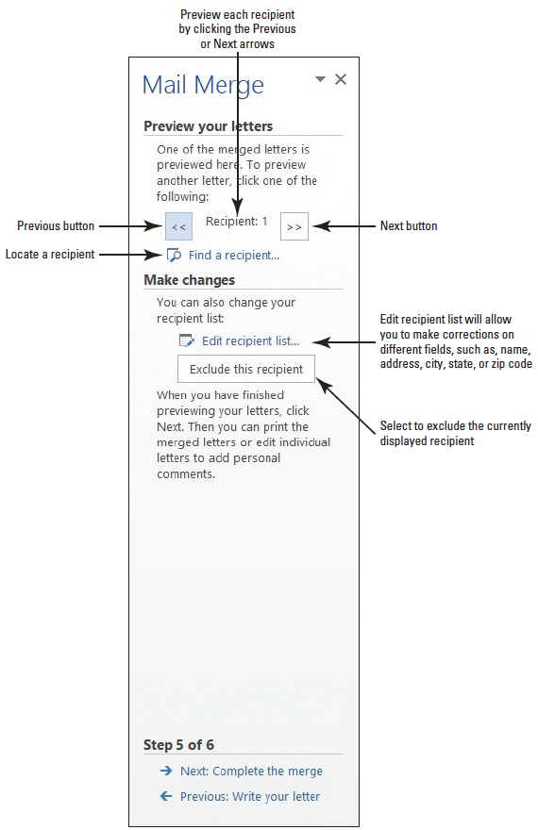
Step 5: Preview Your Letter
At the bottom of the Mail Merge pane, click the Next: Preview your letters link.
Notice the first recipient, Ted Bremer, appears in the document. On the Mail Merge pane, preview each letter in the document screen by using the buttons as shown at right.
Click the Next button, preview each letter, and return to the first recipient.

Slide 22
Step 5: Preview Your Letter
Before finalizing the merge, the mailing address contains extra spaces between the lines that need correction.
Select the text beginning with Ted Bremer, including the address through the zip code, 45632.
Now it is time to format the main letter with the correct spacing so that when you complete the merge, all letters will be updated. On the Home tab, in the Paragraph group, click the drop-down arrow to display the Line and Paragraph Spacing menu and select Remove Space Before Paragraph. This separates the Address Block from the salutation.

Slide 23
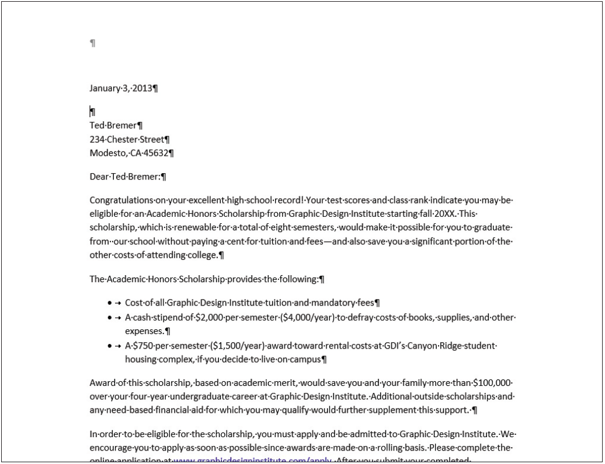
Step 5: Preview Your Letter
The document should display as at right. Preview each letter again by using the Next and Previous buttons on the Mail Merge pane and return to the first recipient. Each recipient should be in the correct format.

Slide 24
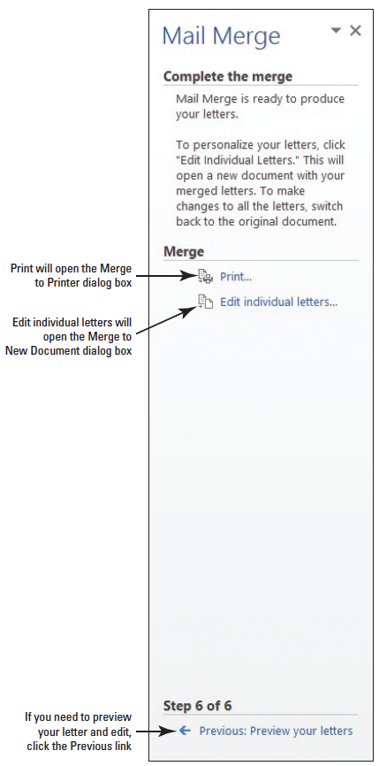
Step 6: Complete the Merge
At the bottom of the Mail Merge pane, click the Next: Complete the merge link to advance to Step 6 as shown at right. The letter is already merged and ready to Print or you can edit each letter individually.
When you click the Edit individual letters link under the Merge section, the Merge to New Document dialog box opens.
When you select the All radio button, Word opens one new document with a copy of the main document for each record, and Letters1 displays on the title bar.

Slide 25
Step 6: Complete the Merge
When you finish editing the letters, you are ready to save the letters—all letters will be saved as one document.
If your insertion point is on the third letter, and you click the Edit individual letters link under the Merge Section of Step 6 and then select the radio button for Current Record, only the third letter opens in a new screen as a new document and Letters followed by a number appears on the title bar.
Edit the document and when you save the document, only the third letter will be saved with the changes made.

Slide 26
Step 6: Complete the Merge
If you select the third radio button From in the Merge to New Document dialog box, you type the beginning number to the end number of the document you want to edit. For example, if you want to edit letter 3 through 5, you type 3 to 5 in the From boxes.
Under Mail Merge pane, in the Merge section, click Print to print each letter. The Merge to Printer dialog box opens with three options to select.
© 2014, John Wiley & Sons, Inc.
Microsoft Official Academic Course, Microsoft Word 2013
26

Slide 27
Step 6: Complete the Merge
Selecting the All radio button prints all letters, the Current record prints the record where your insertion point is located, and From is where you specify which records to print. For example, if you specify records 2 to 4, only those two records will print. Be careful, if you select the Print option for Step 6, you will not be given the opportunity to edit the letters.
Make sure the All radio button is selected and click OK to print.

Slide 28
Step 6: Complete the Merge
Now that you printed all letters, you now need to save the merged letter. Click the Edit individual letters link under the Merge section.
Click OK to open a new document with a letter to all recipients.
SAVE the merge document as Merged Congratulation Letter in the lesson folder on your flash drive, and then CLOSE the file.
CLOSE the Mail Merge pane.

Slide 29

Step 6: Complete the Merge
The main document appears on the screen with the first record being displayed. In the Preview Results on the Mailings tab, click the Preview Results button to disable. Disabling the Preview Results button displays the <<Address Block>> and <<Greeting Line>>.
SAVE the main document as Congratulation Letter in the lesson folder on your flash drive, and then CLOSE the file.
PAUSE. LEAVE Word open to use in the next exercise.

Slide 30
Step by Step: Set Up a Main Document Manually
Create a new blank document by selecting the File tab, and then click New, and click Blank document.
Click the Mailings tab, and in the Start Mail Merge group, click the drop-down arrow to display the Start Mail Merge menu.
Choose Letters. (The same data source used in the previous exercise is used to perform the mail merge manually.)
PAUSE. LEAVE Word open to use in the next exercise.

Slide 31

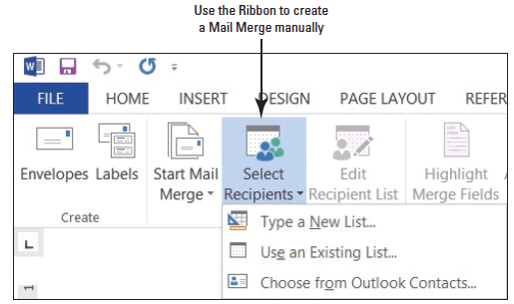
Step by Step: Select Recipients
In the Start Mail Merge group, click the Select Recipients button to display the menu as shown below.
There are three options available. (You will open an existing data source file from your lesson folder. Notice the commands on the Ribbon are faded, therefore, not available until a data source file is opened).

Slide 32
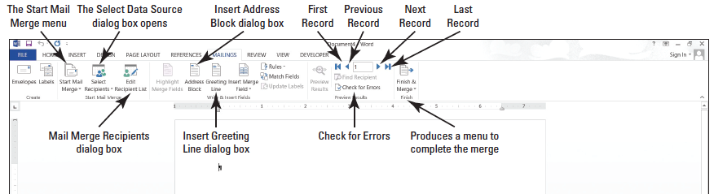
Step by Step: Select Recipients
Select Use an Existing List. The Select Data Source dialog box opens. Use the scroll bar to locate your flash drive and navigate to your data files for the lesson folder.
OPEN the Student List.accdb data source file from the lesson folder. The Student List file is a database.
After opening the data source file, the commands on the Mailings tab on the Ribbon become active (below). When selecting a data source file, this file can be a database, an Excel spreadsheet, a table in Word, or it can be opened from your Outlook contacts.

Slide 33
Step by Step: Select Recipients
At the insertion point, type March 19, 20XX. Press the Enter key twice. By default, the Spacing After is set to 8 pt and later you will format the document to an appropriate business format.
PAUSE. LEAVE the document open to use in the next exercise.
Notes:
Take Note: If the formatting of the date changes, press Ctrl+Z to Undo.

Slide 34
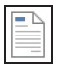
Step by Step: Prepare Merge Fields
USE the document open from the previous exercise.
On the Mailings tab, in the Write & Insert Fields group, click the Address Block button. The Insert Address Block dialog box opens.
When using the Mail Merge Wizard or completing the Mail Merge manually, the same dialog boxes are opened.
Notice that the street address is missing in the preview area. Click the Match Fields. To correct the error, select the drop-down arrow by Address 1 and select the Address Line field. Click OK to close the Match Fields dialog box.

Slide 35
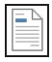
Step by Step: Prepare Merge Fields
Click OK to accept the address settings with the correction.
Press Enter once.
On the Mailings tab, in the Write & Insert Fields group, click the Greeting Line button. The Insert Greeting Line dialog box opens.
For the Greeting Line format, the salutation Dear will be used. You use the default where Joshua Randal Jr. is shown.
Change the comma to a colon.
Click OK. Press Enter once.
PAUSE. LEAVE the document open to use in the next exercise.

Slide 36
Step by Step: Write the Letter
USE the document open from the previous exercise.
Type the following letter:
The president of the college, Dr. Jose A. Torres, is extending an invitation to all students who received scholarships for the next academic semester. The Graphic Design Institute recognizes all students for their academic excellence. A reception is being held in your honor on March 29 at 12 noon in the President’s Conference Room 19. [Press Enter once.]

Slide 37
Step by Step: Write the Letter
Please confirm your attendance by calling 915-999-9999. [Press Enter once.]
Regards, [Press Enter twice.]
Jerry Wright [Press Shift+Enter to insert a line break.]
Scholarship Committee Chair
PAUSE. LEAVE the document open to use in the next exercise.

Slide 38

Step by Step: Preview the Document
USE the document open from the previous exercise.
In the Preview Results group, click the Preview Results button. The first recipient appears. Click the Next Record arrow button to preview the letters for each recipient.
Disable Preview Results by clicking the Preview Results button again.
Place the insertion point in the <<AddressBlock>> field. Click the Home tab, and then in the Paragraph group, click the Line and Paragraph Spacing button, and then click Remove the Spacing After Paragraph.

Slide 39
Step by Step: Preview the Document
Place the insertion point in the <<Greeting Line>> and click the Page Layout tab. In the Paragraph group, click the Spacing Before up arrow until you see 6 pt. The Spacing Before is increased by 6 pts and separates the address block and greeting line.
On the Page Layout tab, in the Page Setup group, click the Margins button, and then click Custom Margins. Type 2 in the Top box to change the top margin. Click OK.
Customized letterheads are used by organizations to print their letters. The top margin must be adjusted to avoid text printing over the organization’s logo.

Slide 40
Step by Step: Preview the Document
Click the Mailings tab, in the Preview Results group, and click the Preview Results button to view the formatting changes made to the document. After you finish your review, disable Preview Results.
The main document is the document that contains the body of the letter as well as the Address Block and Greeting Line merge codes.
SAVE the main document as Reception Letter in the lesson folder on your flash drive.

Slide 41
Step by Step: Preview the Document
Saving the main document as a separate document allows you to merge with a new data source file—when you need to use the same letter again but with a different recipient list. When you open a main document that contain field codes, Word asks you for the data source file.
PAUSE. LEAVE the document open to use in the next exercise.
Notes:
Take Note: Once the main document has been set up, you can format at the beginning of the mail merge process.

Slide 42
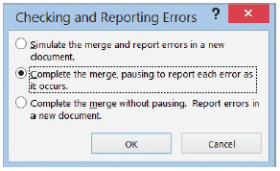
Step by Step: Check for Errors
USE the document open from the previous exercise.
On the Preview Results group, click the Check for Errors button. The Checking and Reporting Errors dialog box opens as shown at right.
Select the first option, Simulate the merge and report errors in a new document.
Click OK.
A prompt appears indicating No mail merge errors have been found in the Reception Letter. Click OK.
PAUSE. LEAVE the document open to use in the next exercise.

Slide 43
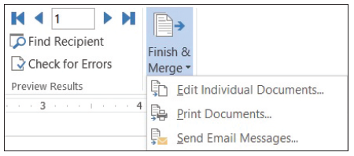
Step by Step: Complete the Merge
USE the document open from the previous exercise.
In the Finish group, click the drop-down arrow to display the Finish & Merge menu as shown below.

Slide 44
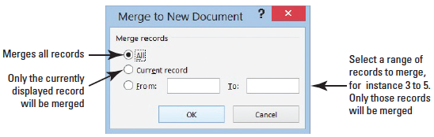
Step by Step: Complete the Merge
Select Edit Individual Documents. The Merge to New Document dialog box opens as shown below.
The All option merges all letters to a new document, Current record merges only that record on which your insertion point is positioned, and in the From option, you type the first record and end record to merge. For instance, to merge only records 2 and 3, you type 2 to 3.

Slide 45
Step by Step: Complete the Merge
For this exercise, in the From section, type 3 in the first box and in the To box, type 5. Click OK. A new document is produced that displays letters for records 3 through 5 in one document. Scroll through the document to preview that the document is ready to print.
SAVE the merged document as Merged Reception Letter in the lesson folder on your flash drive, and then CLOSE the file.

Slide 46
Step by Step: Complete the Merge
CLOSE the main document Reception Letter and a prompt appears asking, Do you want to save changes made to Reception Letter? Click SAVE.
When you save the main document with the field codes, you will be able to return to your document and recipient list and use the tools available in the Mailings tab. You can also edit the list of recipients and open another data source to send the same letter to another group. When saving the main document, make sure you turn off the Preview Results.
PAUSE. LEAVE Word open for the next exercise.
Notes:
Troubleshooting: A document must be opened in Word for the mail merge commands to be available.

Slide 47
Step by Step: Merge a Letter with a Table
OPEN an existing document from the lesson folder.
OPEN the Scholarship document. (The same letter used in a previous exercise will be used).
Click the Mailings tab, and in the Start Mail Merge group, click the Start Mail Merge button. Choose Letters.
In the Start Mail Merge group, click the Select Recipients button to display the menu.
Select Use an Existing List. The Select Data Source dialog box opens. Use the scroll bar to locate your flash drive and navigate to your data files for the lesson folder.

Slide 48
Step by Step: Merge a Letter with a Table
OPEN the Student Listing.docx data source file from the lesson folder. The Student Listing file was created as a table in Word. The data source file is a table that contains fields as headers with the records displayed within the table.
At the insertion point, type November 28, 20XX. Press Enter twice.
Click the Address Block button to open the Insert Address Block dialog box. Notice that the preview area does not display the street address.
Notes:
Cross Reference: In Lesson 6, you learn to create tables using different methods.
Take Note: If the formatting of the date changes, press Ctrl+Z to Undo.

Slide 49
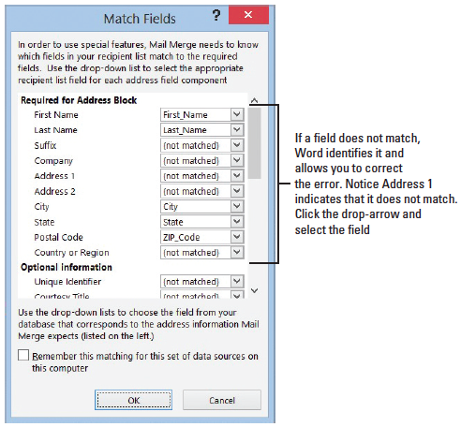
Step by Step: Merge a Letter with a Table
Click the Match Fields button to correct the problem. The Match Fields dialog box opens as shown at right. Under Required for Address Block, Address 1 displays Not Matched because the field heading in the table is listed as Address Line and does not directly match the Address Block in Word.

Slide 50
Step by Step: Merge a Letter with a Table
Click the drop-down arrow next to Address 1, select Address_Line, and then click OK to close the dialog box.
Review the preview area and notice that the problem has been corrected and the address is now displayed correctly.
Click OK to close the Insert Address Block dialog box. Press Enter once.
Insert the Greeting line and change the punctuation to a colon. Press Enter once.

Slide 51
Step by Step: Merge a Letter with a Table
Click the Preview Results button and notice the spacing in the Address Block needs to be formatted correctly.
Select the <<Address Block>> and in the Page Layout tab, decrease the Spacing Before to zero.
Change the top margin to 2".
Preview the results before finishing the merge.
Click the Finish & Merge button, and then click Edit Individual Documents.

Slide 52
Step by Step: Merge a Letter with a Table
In the Merge to New Document dialog box, keep t e defaults and click OK. The document opens a new screen with the merged document displaying all records.
SAVE the document as Merged Academic Honors Scholarship in the lesson folder on your flash drive, and then CLOSE the file.
Make sure you turn off the Preview results so that the field codes are displayed in the main document. SAVE the main document as Academic Honors Scholarship Letter in the lesson folder on your flash drive, and then CLOSE the file.
PAUSE. LEAVE Word open for the next exercise.

Slide 53
Step by Step: Merge a Letter with Excel
OPEN the Scholarship document from the lesson folder.
Click the Start Mail Merge button from the Mailings tab and select the Step-by-Step Mail Merge Wizard to open the Mail Merge pane.
Under the Select document type section, Letters is the default. Click Next: Starting document.
Select the Use the Current Document radio button.
Click Next: Select recipients from the Mail Merge pane to advance to the next step.
Under the Select recipients section, the defaults will be used. Click the Browse…button and locate the Student List.xlsx file. The format for this document is in a spreadsheet format. In the Select Data Source dialog box, locate the Student List from the lesson folder—use the scroll bar to view the Type—it should read Microsoft Excel Worksheet. Click Open.

Slide 54
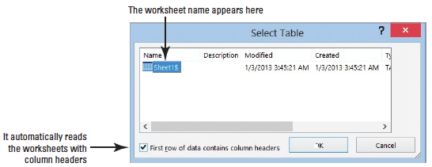
Step by Step: Merge a Letter with Excel
The Select Table dialog box opens as shown below. The first row of data contains column headers and Word automatically recognizes the headings in the worksheet. Click OK.The Mail Merge Recipients dialog box opens. Notice that under the Data Source heading, it shows the file data source as Student List.xlsx.
Click OK to close the dialog box.
Close the Mail Merge pane.

Slide 55
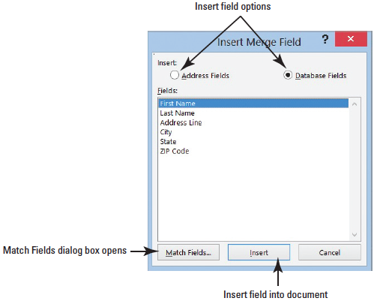
Step by Step: Merge a Letter with Excel
Position the insertion point at the beginning of the document and insert the current date.
Press Enter twice.
Click the Insert Merge Field button to open the Insert Merge Field dialog box (right).
With the First Name selected, click the Insert button to insert the <<First_Name>> field code in the document.

Slide 56
Step by Step: Merge a Letter with Excel
Click the Close button to close the Insert Merge Field dialog box.
Click the Insert Field Merge drop-down arrow to display the fields. This is another way to also insert field codes in a document.
Select Last_Name to insert the <<Last_Name>> field code in the document.
Press Enter to create a blank line.
Click the drop-down arrow by the Insert Merge Field and select Address_Line to insert the <<Address_Line>> field code in the document.
Press Enter to create a blank line.
Click the drop-down arrow by the Insert Merge Field and select City to insert the <<City>> field code in the document.

Slide 57
Step by Step: Merge a Letter with Excel
Type a comma after <<City>> and press the spacebar once.
Click the drop-down arrow by the Insert Merge Field and select State to insert the <<State>> field code in the document; press the spacebar once.
Click the drop-down arrow by the Insert Merge Field and select Zip_Code to insert the <<Zip_Code>> field code in the document.
Press Enter once to create a blank line.
Type Dear and press the spacebar once.
Click the drop-down arrow by the Insert Merge Field and select First_Name to insert in the document.
Press the spacebar once.

Slide 58
Step by Step: Merge a Letter with Excel
Click the drop-down arrow by the Insert Merge Field and select Last_Name to insert in the document.
Type a colon after <<Last_Name>>.
Notice the spacing between the lines of the field codes.
Select <<First_Name>> through <<Zip_Code>>.
In the Page Layout tab, decrease the Spacing Before to zero and change the top margin to 2". Preview the results before finishing the merge.
Click the Finish & Merge button, and then click Edit Individual Documents.
In the Merge to New Document dialog box, keep the defaults and click OK. The document opens a new screen with the merged document displaying all records.
SAVE the document as Merged Academic Scholarship in the lesson folder on your flash drive, and then CLOSE the file.

Slide 59
Step by Step: Merge a Letter with Excel
Make sure you turn off the Preview results so that the field codes are displayed in the main document and close the Mail Merge pane.
SAVE the main document as Academic Scholarship Letter in the lesson folder on your flash drive, and then CLOSE the file.
PAUSE. LEAVE Word open for the next exercise.

Slide 60
Step by Step: Merge a Letter with Access
OPEN the Scholarship document from the lesson folder.
Click the Start Mail Merge button from the Mailings tab and select the Step-by-Step Mail Merge Wizard to open the Mail Merge pane.
Under the Select document type section, Letters is the default. Click Next: Starting document.
Select the Use the current document radio button.
Click Next: Select recipients from the Mail Merge pane to advance to the next step.

Slide 61
Step by Step: Merge a Letter with Access
Under the Select recipients section, the defaults will be used. Click the Browse…button and locate the Student List.accdb file. The format for this document is in a database format. In the Select Data Source dialog box, locate the Student List from the lesson folder—use the scroll bar to view the Type—it should read Microsoft Access Database.
Click Open. The Mail Merge Recipients dialog box opens. Notice that under the Data Source heading and preview area, the file data source displays as Student List.accdb.

Slide 62
Step by Step: Merge a Letter with Access
Click OK to close the Mail Merge Recipients dialog box.
Click Next: Write your letter.
Position the insertion point at the beginning of the document and insert the current date.
Press Enter twice.
Insert the Address Block and notice that the street address is missing in the preview area.

Slide 63
Step by Step: Merge a Letter with Access
Click the Match Fields (right). To correct the error, select the drop- down arrow and select the Address Line field.
Click OK again.
Press Enter once.

Slide 64
Step by Step: Merge a Letter with Access
Click the Preview Results button and notice the spacing in the Address Block needs to be formatted correctly. Select the <<Address Block>> and in the Page Layout tab, decrease the Spacing Before to zero and change the top margin to 2". Preview the results before finishing the merge.
Insert the Greeting line, accept the default settings, and click OK.
Click the Finish & Merge button, and then click Edit Individual Documents.

Slide 65
Step by Step: Merge a Letter with Access
In the Merge to New Document dialog box, keep the defaults and click OK. The document opens a new screen with the merged document displaying all records.
SAVE the document as Merged Academic Scholarship Letter in the lesson folder on your flash drive, and then CLOSE the file.
Make sure you turn off the Preview results so that the field codes are displayed in the main document and close the Mail Merge pane. SAVE the main document as Academic Scholarship Main Letter in the lesson folder on your flash drive, and then CLOSE the file.
PAUSE. LEAVE Word open for the next exercise.

Slide 66
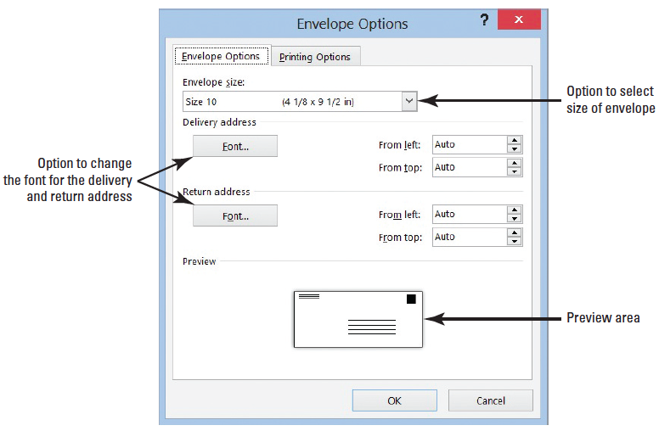
Step by Step: Create an Envelope
OPEN a blank document.
Click the Mailings tab, and in the Start Mail Merge group, click the Start Mail Merge button.
Choose Envelopes. Envelope Options dialog box opens as displayed at right.

Slide 67
Step by Step: Create an Envelope
Use the default settings, and click OK. In this screen, you have the option to change the size of the envelope and font for the delivery and return address.
Click the Select Recipients button and select Use an Existing List. The Select Data Source dialog box opens. Navigate to your data files for the lesson folder.
OPEN the Student List.accdb (database) data source file from the lesson folder. Each time you open a data source file, the commands on the Ribbon become active.
Place the insertion point in the delivery address location in the envelope, and then click the Address Block button. As shown in the preview area, the fields do not match and the address needs to be corrected.
Click the Match Fields button.

Slide 68
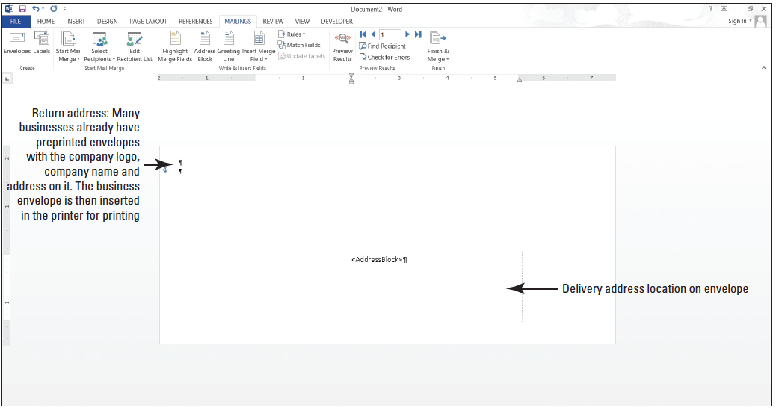
Step by Step: Create an Envelope
To correct the Address 1 field, click the drop-down arrow and select Address_Line. Click OK. The address has been corrected and ready to be merged.
Click OK again to close the Address Block dialog box.
Preview the envelopes by clicking the Preview Results button, and then review each record in the envelope and return to the first record. Turn off the Preview Results. The envelope should match the figure above.

Slide 69
Step by Step: Create an Envelope
Complete the merge by clicking the Finish & Merge button.
Select Edit Individual Document, and then click OK. Each record has its own envelope and you are ready to print. Check with your instructor before printing.
SAVE the envelope as Merged Scholarship Envelope in the lesson folder on your flash drive, and then CLOSE the file.
Make sure you turn off the Preview results so that the field codes are displayed in the main document.
SAVE the main document as Scholarship Main Envelope in the lesson folder on your flash drive, and then CLOSE the file
PAUSE. LEAVE Word open for the next exercise.

Slide 70
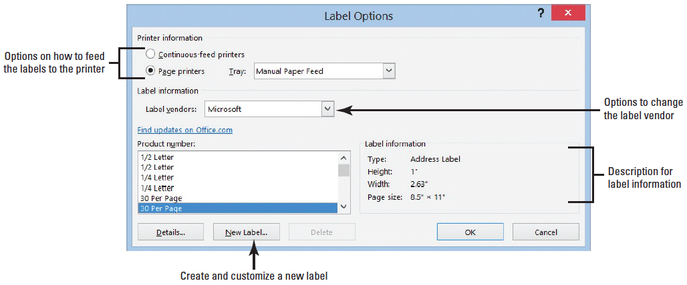
Step by Step: Create Labels
OPEN a blank document.
From the Mailings tab, in the Start Mail Merge group, click the Start Mail Merge button. Choose Labels. The Label Options dialog box opens as displayed below. You have options to change vendors and product number.

Slide 71
Step by Step: Create Labels
Change the Product number to 30 Per Page with the dimensions of Type: Address Label, Height: 1"; Width: 2.63”; Paper size: 8.5” x 11”. Click OK.
Click the Select Recipients button and select Use an Existing List. The Select Data Source dialog box opens. Navigate to your data files for the lesson folder.
OPEN the Student List.accdb (database) data source file from the lesson folder.As discussed, each time you open a data source file the commands on the Ribbon become active. The first label appears blank whereas the remaining labels displays <<Next Record>>.
Click the Address Block button to begin inserting the Address Block.

Slide 72
Step by Step: Create Labels
Notice that the fields do not match.
Correct the address by clicking the Match Fields button.
To correct the Address 1 field, click the drop-down arrow and select Address_Line.
Click OK.
The address line has been corrected as shown in the preview area.
Click OK again to close the Address Block dialog box.

Slide 73

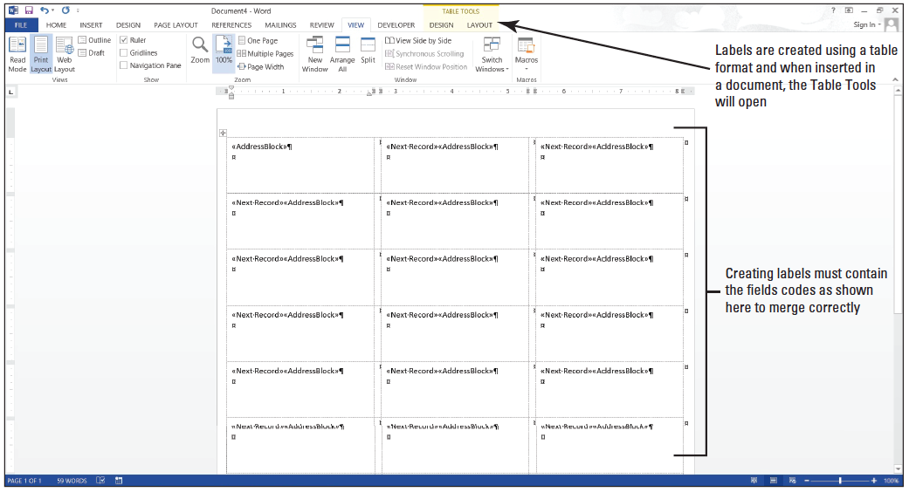
Step by Step: Create Labels
Click the Update Labels button in the Write & Insert Fields group. The Address Block appears on each label as shown below. Labels are created using the table format and when opened, the Table Tools opens. The skills that you learn in Lesson 6 can be applied to format labels.

Slide 74
Step by Step: Create Labels
Preview the labels by clicking the Preview Results button. Each record appears on the label. Turn off the Preview Results.
The next step is to complete the merge. Click the Finish & Merge button. Select Edit Individual Document, and then click OK.
SAVE the merged label as Merged Scholarship Label in the lesson folder on your flash drive, and then CLOSE the file.
SAVE the main label document as Scholarship Main Label in the lesson folder on your flash drive, and then CLOSE the file.

Slide 75
Skill Summary

